Slide 1
Puzzle game

Slide 2
Content:-
Idea.
Game code.
Tutorial for play the game.

Slide 3
Idea:
I want to save Security Graphs in my mind easily, so I create a puzzle game to help me In this .

Slide 4
Game code:-
I used unity 3D version(5.4.5 f1) .
Main menu UI code (UI_Manager.cs file).
(GameMaster.cs file) that will remain till the game running and get some data from game memory.
Levels pause menu and submenus (UI_Manager_Levels.cs file).
(Timer.cs file) act like timer.
(Move_Piece.cs file) that make pieces of puzzle move with mouse when pressed.
(SpriteNameMatch.cs file) hold the piece name to match them.
(LevelManager.cs file) that manage every thing in levels.
(EndMenuManager.cs file) that manage end menu.

Slide 5
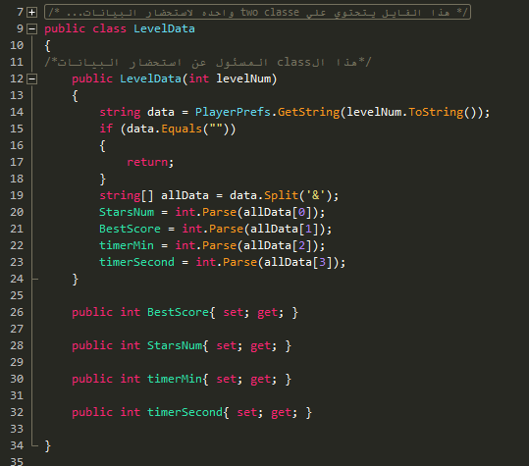
Game code: (cont)
UI_Manager.cs file
This class in UI_Manager.cs file for retrieving the data for every level in the game.

Slide 6
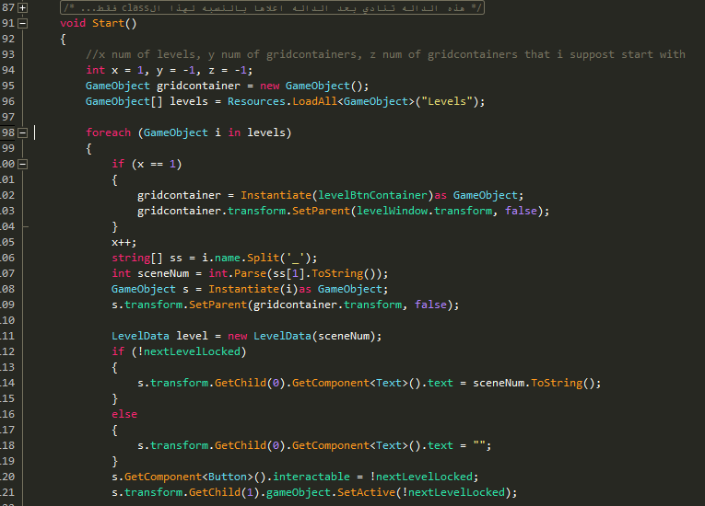
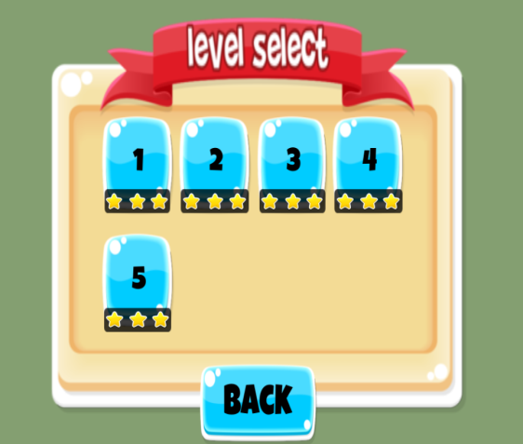
Game code: (cont)
UI_Manager.cs file
This method in class UI_Manager and its one predefined method in unity call in the beginning of the game and I create buttons in this menu from resources file and retrieve the data about every level.

Slide 7
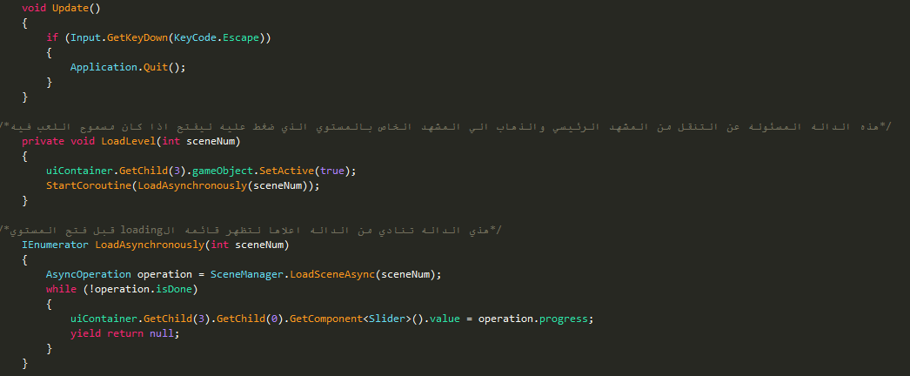
Game code: (cont)
UI_Manager.cs file
In this method I check if ESC button is press for quit the game in main menu
In this two methods I open any level scene by it’s number and while it open I user synchronised method (IEnumerator) to open loading progress bar

Slide 8
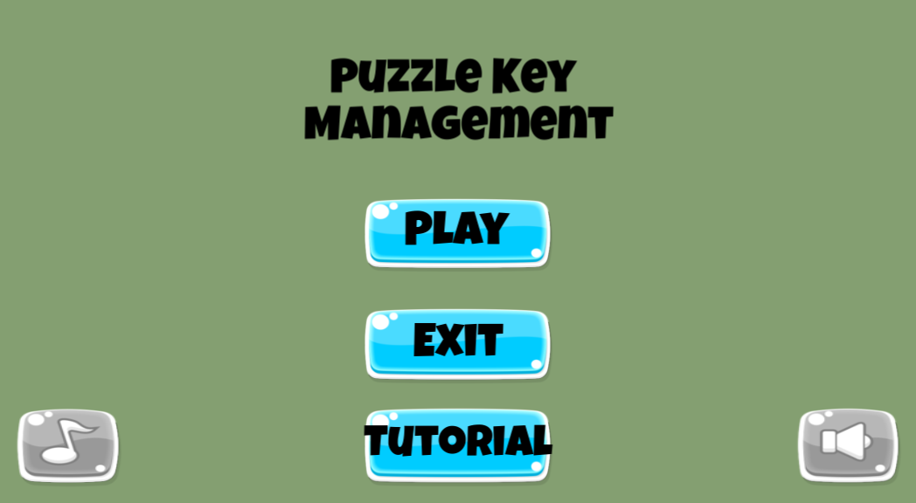
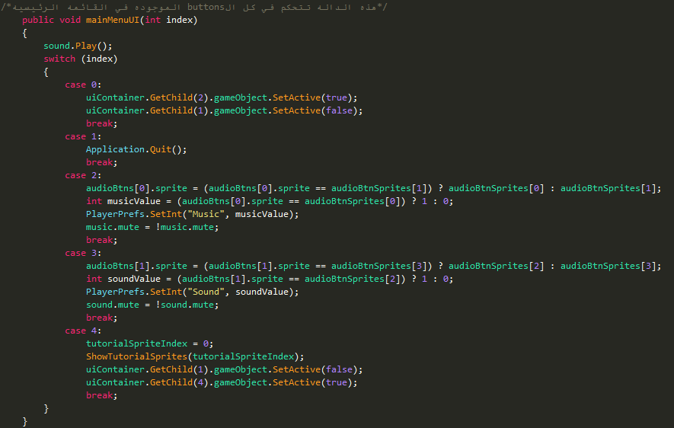
Game code: (cont)
UI_Manager.cs file
This method control buttons in main menu

Slide 9
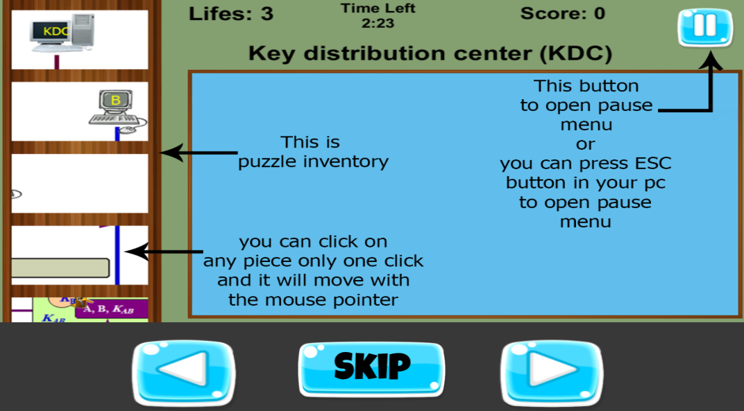
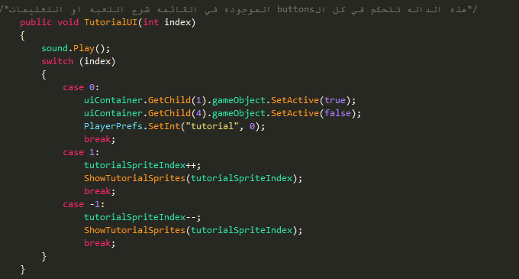
Game code: (cont)
UI_Manager.cs file
This method control buttons in Tutorial menu

Slide 10
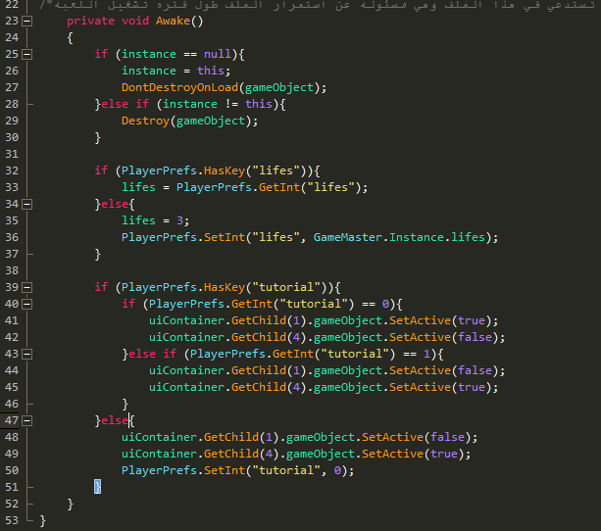
Game code: (cont)
GameMaster.cs file
This method is also predefined and I retrieve lifes of the player and did he see the tutorial or not

Slide 11
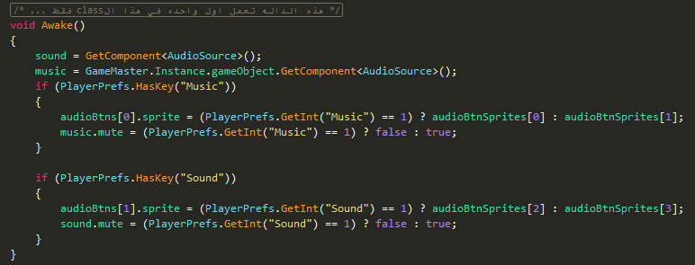
Game code: (cont)
UI_Manager_Levels.cs file
This method is also predefined and I retrieve sound and music is on or off.

Slide 12
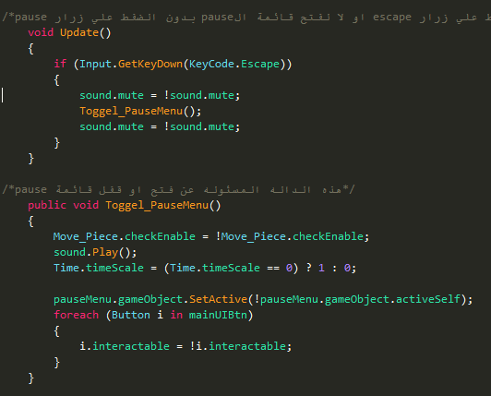
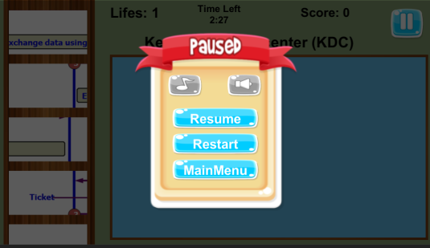
Game code: (cont)
UI_Manager_Levels.cs file
This method is also predefined and i turn on or off the pause when I press ESC button in any Level
This method is responsible for turn on or off pause menu and called from pause button or resume button

Slide 13
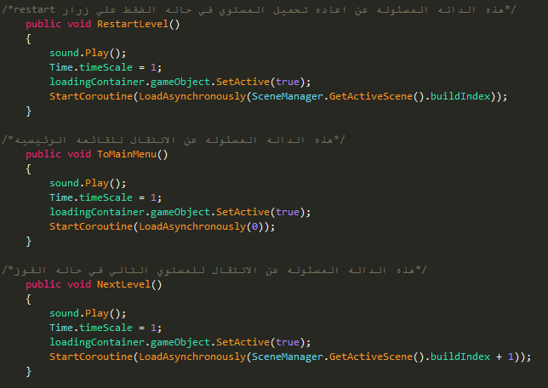
Game code: (cont)
UI_Manager_Levels.cs file
This method for restart the level.
This method for go to main menu.
This method for go to the next level.

Slide 14
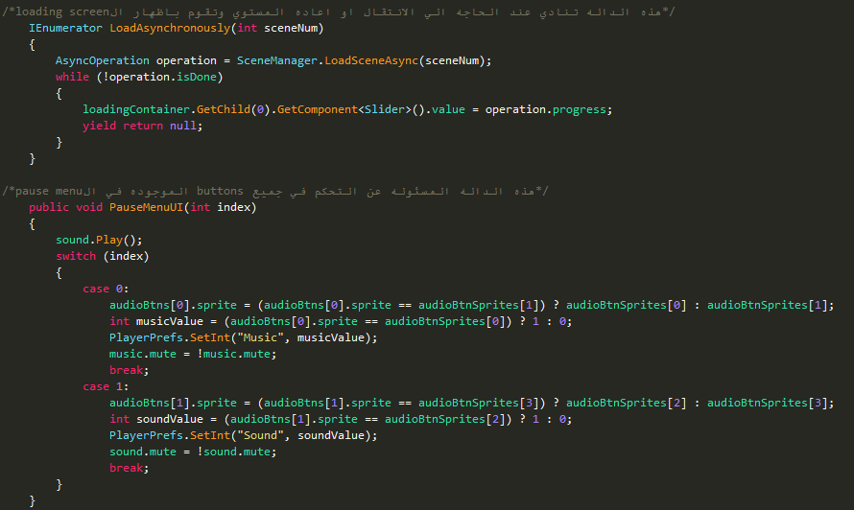
Game code: (cont)
UI_Manager_Levels.cs file
In this method I open any level scene by it’s number and while it open I user synchronised method (IEnumerator) to open loading progress bar by classes AsyncOperation for progress bar and SceneManager for load scenes.
This method control pause menu buttons

Slide 15
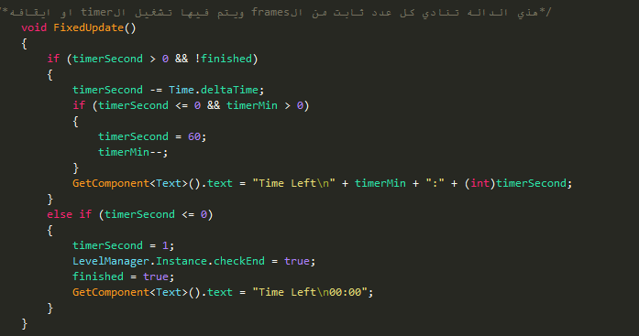
Game code: (cont)
Timer.cs file
In this method responsible for timer and if the it end or not and I calculate time in second by Time class .

Slide 16
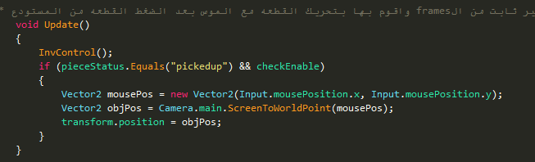
Game code: (cont)
Move_Piece.cs file
This method is also predefined and use it to move pieces in inventory up and down by calling InvControl() method and to move piece with mouse if the player press it and change pieceStatus to “pickedup”

Slide 17
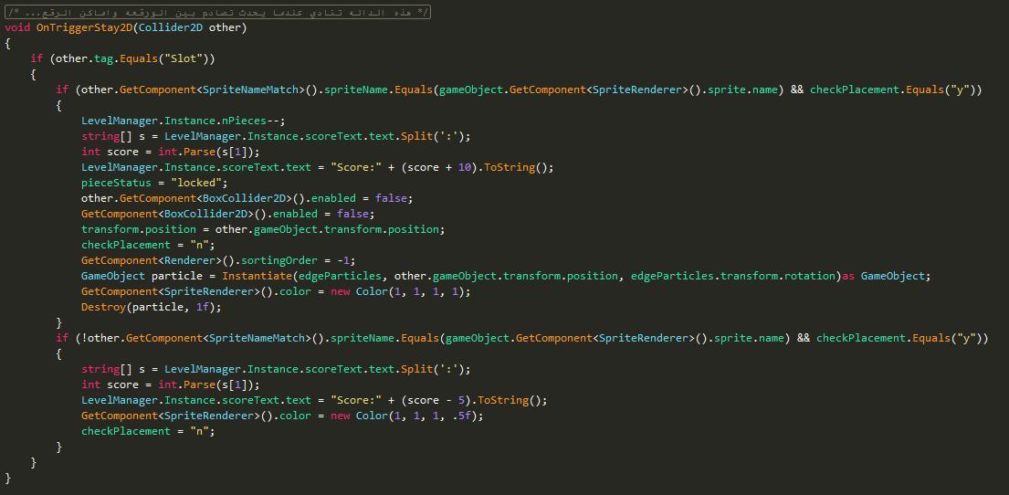
Game code: (cont)
Move_Piece.cs file
This method is also predefined and run only when colliders on piece and puzzle place trigger, and I check if name of sprite of piece equal the name in SpriteNameMatch.cs attached to place that you want to put piece in it.

Slide 18
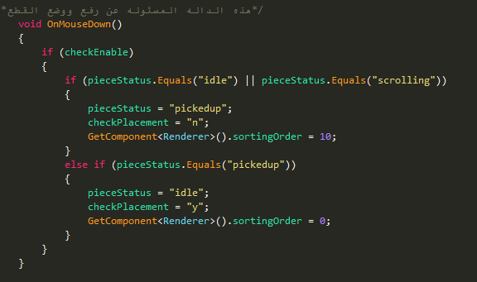
Game code: (cont)
Move_Piece.cs file
This method is also predefined and called when you press any piece in condition the piece is attached with this file and this method is responsible for changing pieceStatus

Slide 19
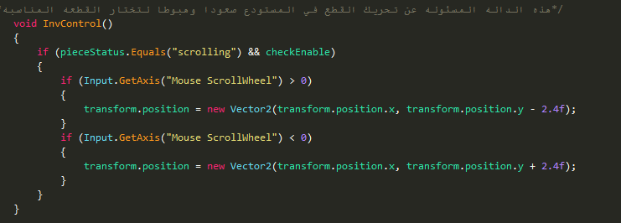
Game code: (cont)
Move_Piece.cs file
This method is responsible for moving pieces in the inventory while it’s status is still “scrolling”

Slide 20
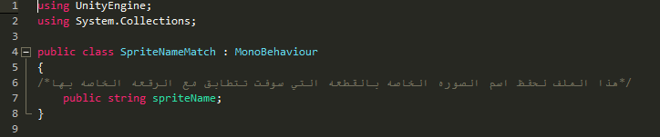
Game code: (cont)
Move_Piece.cs file
This class is responsible for holding the sprite name to matching it in OnTriggerStay2D() method and this class every place have object form it to save the name of sprite that match the place.

Slide 21
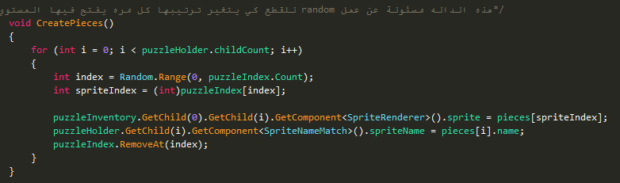
Game code: (cont)
LevelManager.cs file
This method is responsible for randomize the sprite of the pieces and I use arraylist (puzzleIndex) ,and array (pieces) in it.

Slide 22
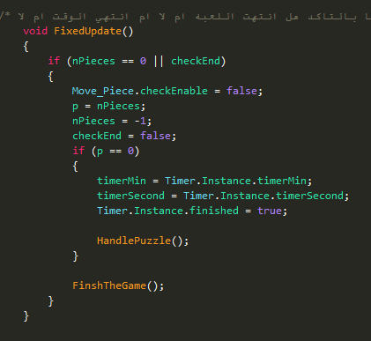
Game code: (cont)
LevelManager.cs file
This method is predefined also and responsible for checking the end of the game by end time or solve the puzzle by put all pieces in their right places.

Slide 23
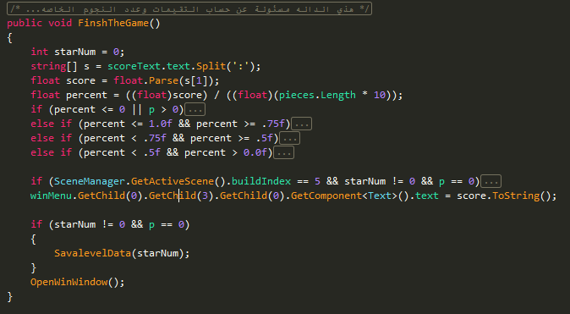
Game code: (cont)
LevelManager.cs file
This method is responsible for calculating your rate in the level and calculating the number of stars (if your score is less than zero you lose and if there is still pieces haven’t placed yet).

Slide 24
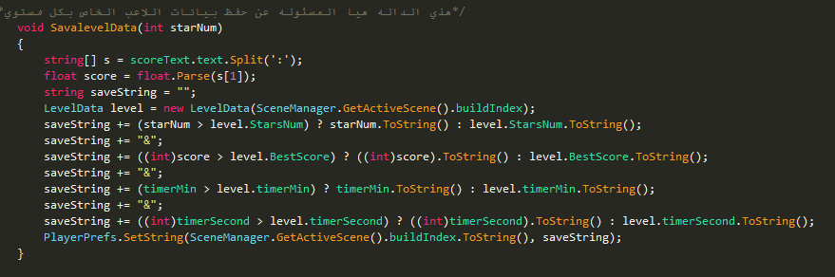
Game code: (cont)
LevelManager.cs file
This method is responsible for saving your rates in the level by using LevelData class to retrieve level data (if found) and save it by PlayerPrefs class.

Slide 25
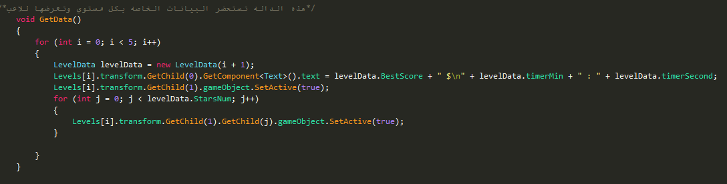
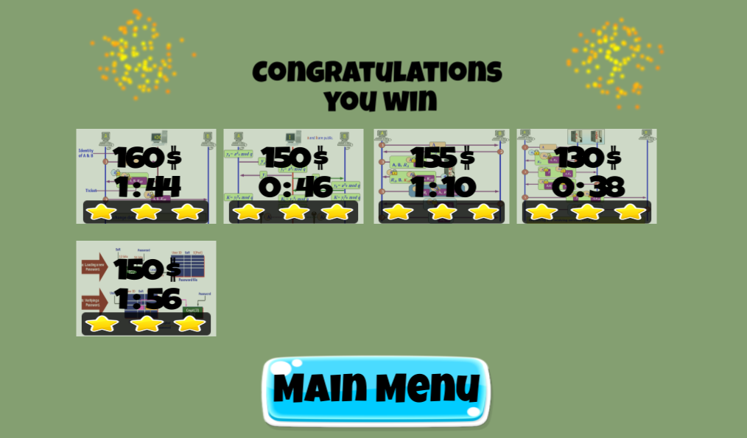
Game code: (cont)
EndMenuManager.cs file
This method is responsible for retrieving your rates in every level by using LevelData class and assign it to every image in EndMenu scene .

Slide 26
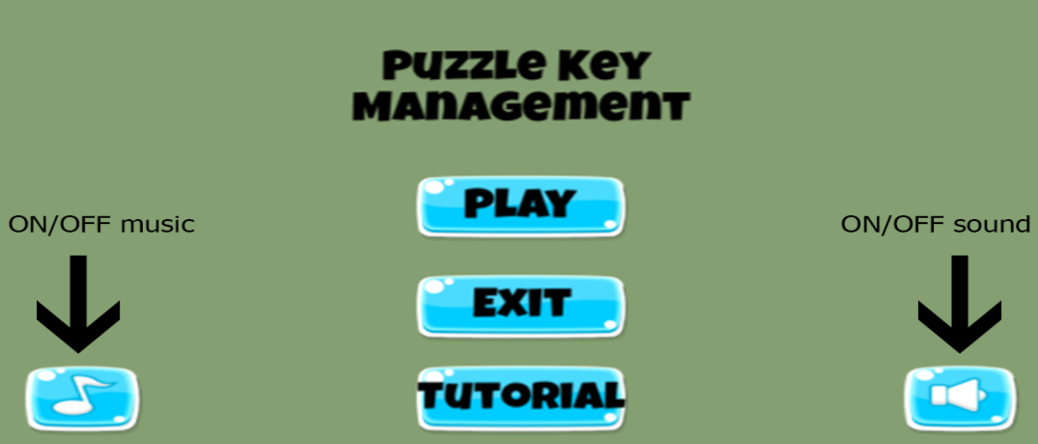

Tutorial for play the game:

Slide 27
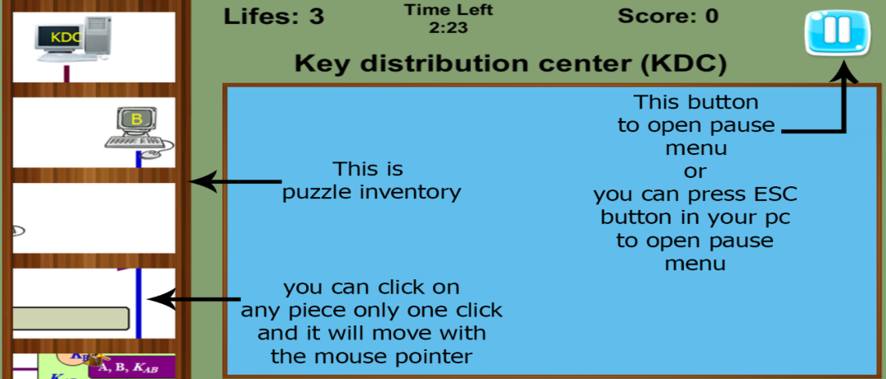
Tutorial for play the game : (cont)

Slide 28
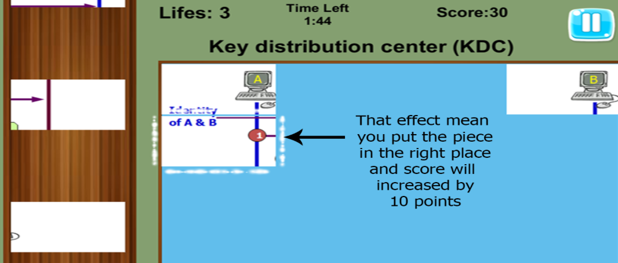
Tutorial for play the game : (cont)

Slide 29
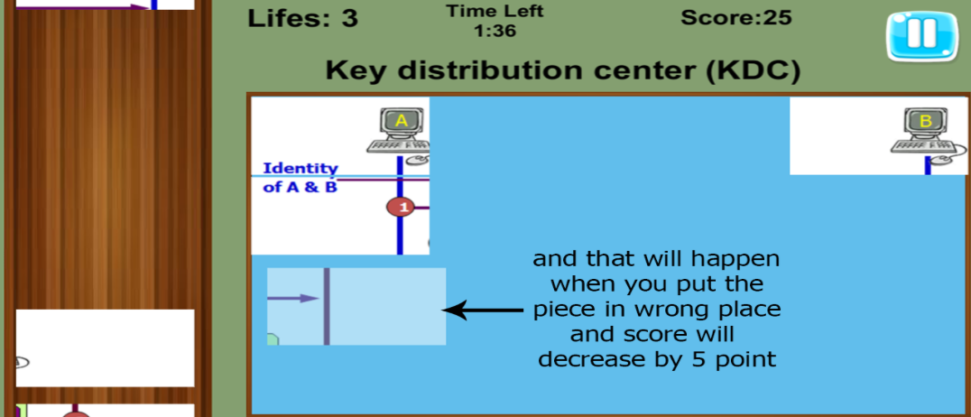
Tutorial for play the game : (cont)

Slide 30
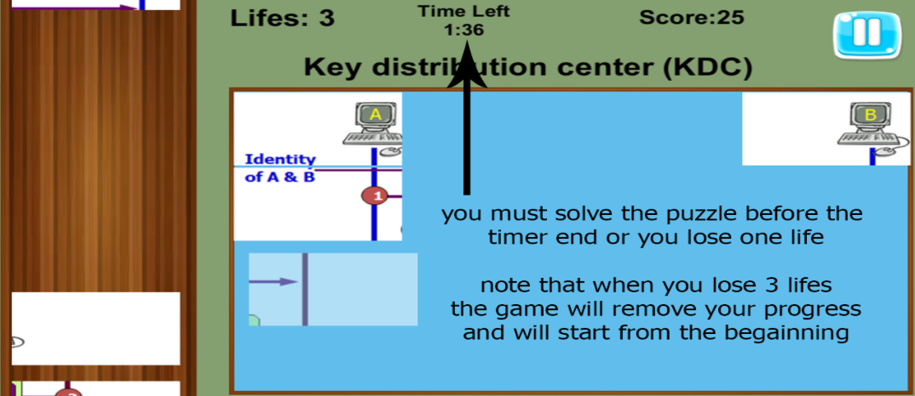
Tutorial for play the game : (cont)

Slide 31
The End

